Slide 1
Enterprise Monitoring and Governance
Nalin Agrawal: Sales Engineering Manager INDIA
Notes:
Before we get started with the demonstration, I’d like to quickly level set by sharing some current observations we’ve seen happening across IT organizations when it comes to monitoring and observability.
We can compare how these align or differ from your situation and of course we’ll review what makes Dynatrace unique, talk about how it works, and then jump right into the demo.
Sound good? Okay, great. Let’s get into it.

Slide 2
What in this presentation
Working of the model
Overall Approach
Timelines

Slide 3
Working of the Model

Slide 4

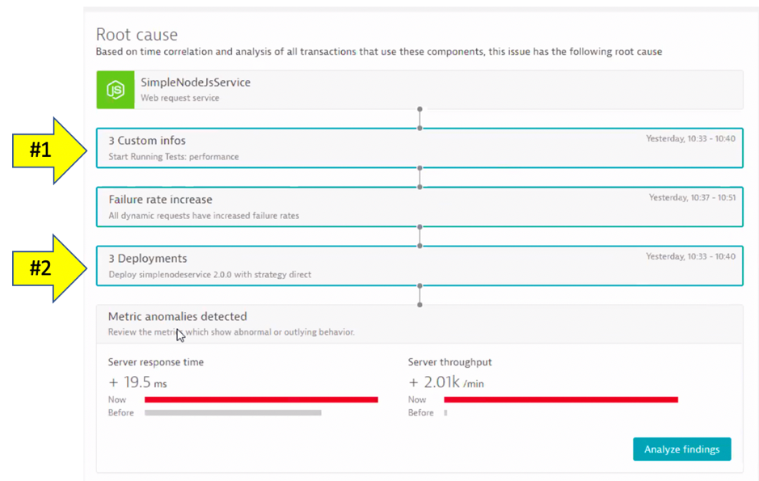
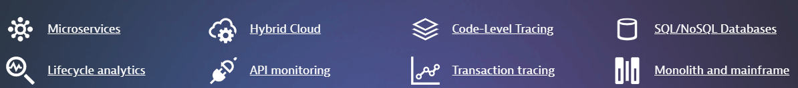
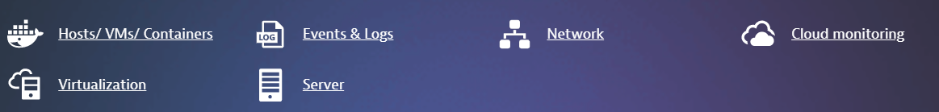
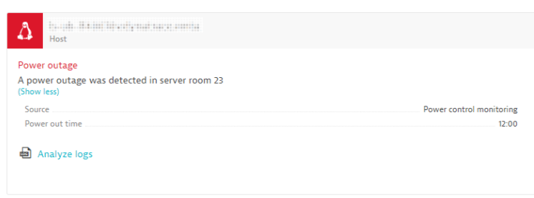



Apps
Infra
Changes
Dynatrace Events APIs – allows to send external event to Dynatrace
Sense
Think
Act

Slide 5

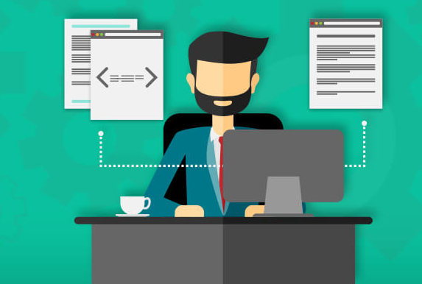






Project governance and success model
Technical Application Owner
Application Developers
Solution Architect
Application Testers
Weekly Project Meeting
Account Director
Project Executive Sponsor
Delivery Team
Project Governance
QBR
Adoption Plan
Architect
Consultant
Monthly Steering Committee
IT Operations
Application Support
Dynatrace One Premium Services:
Customer Success Manager
Product Specialist
Bank Wide Chat Service
Global Support
Platform Engineer(s)
Certification

Slide 6
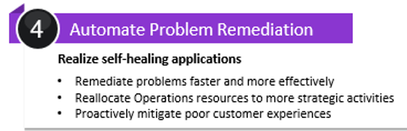
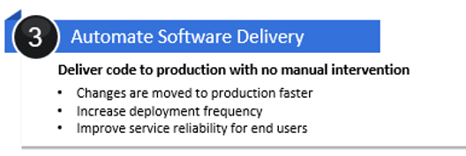
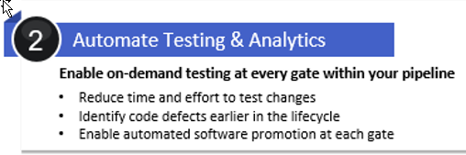
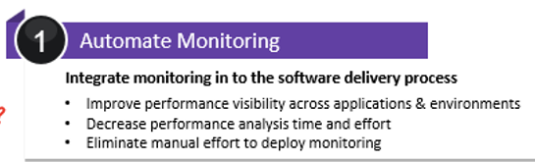
Yet to achieve
Self Healing
Fully automated delivery pipeline
On-demand Quality validation
Self-service monitoring
We are here

Slide 7
Yet to achieve
Self Healing
Fully automated delivery pipeline
On-demand Quality validation
Self-service monitoring
We are here

Slide 8




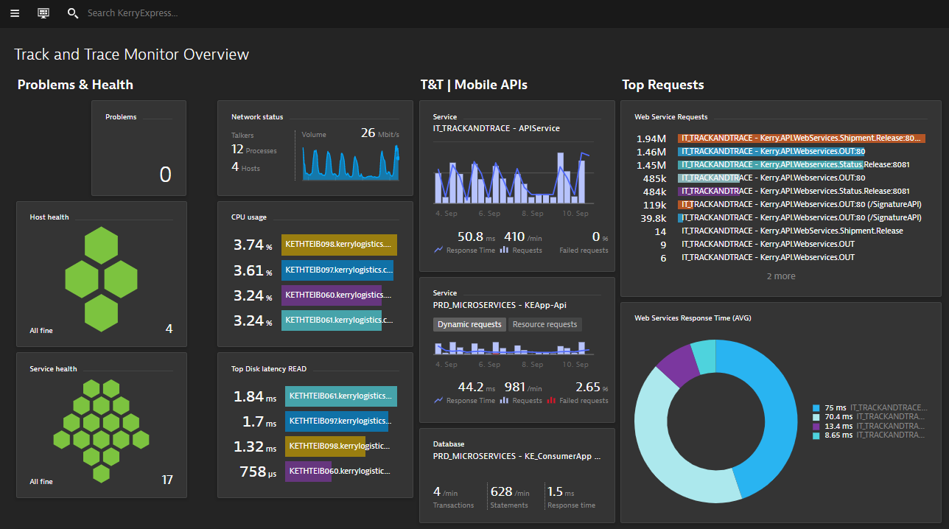


Operational change to incident management
Before (L1 routing)
After (Straight to L1.5/L2)
L1
L2
8

Slide 9


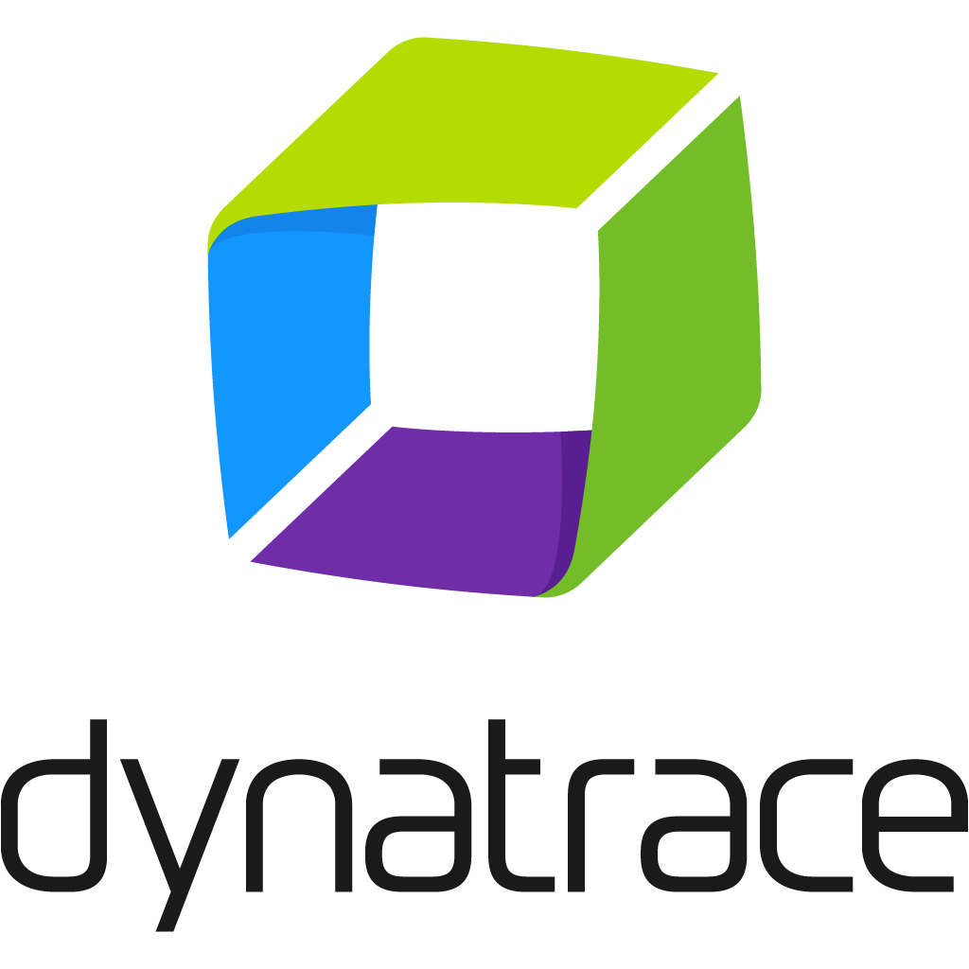





Proposed Incident Workflow
L2
L3
Monitor dashboard
Playbook workflow
Root cause analysis
Ticketing (ITSM)
Incident occurs
Impact analysis
Stakeholders
Alert grouping

Slide 10






Sample Customer Governance Model – Service Gate Plan
Key Milestones & Planned Activities
Project Management Review
Project Management Review
Project Management Review
Project Management Review
Kickoff Session
QuickStart
Health & Velocity Check
Health & Velocity Check
“Daily Status Emails”
“Daily Status Emails”
“Weekly Status Meetings”
“Weekly Status Meetings”
Q1
Q2
Q3
Q4
Q1
Remote Operation Center (ROC)
Live Chat
App Triage
On-Going Weekly Activities
Enablement & Coaching Sessions
Weekly Planner
Staff Proficiency Check
Weekly Performance Report and Review

Slide 11
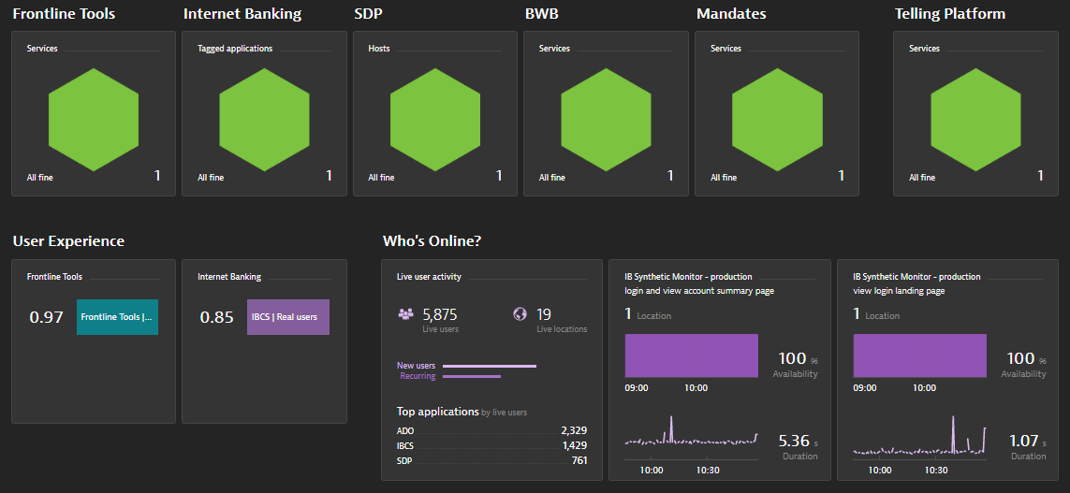
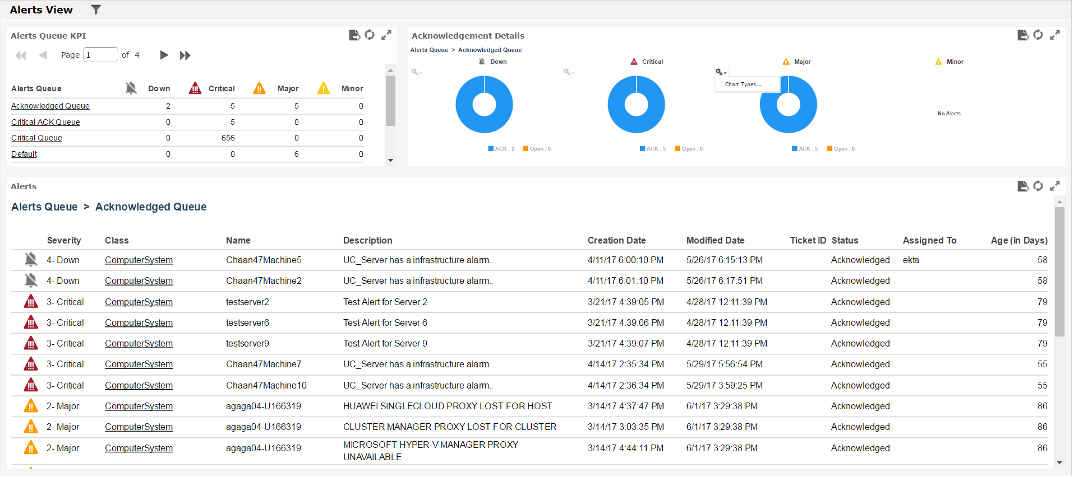
Overall Model Timelines
Aware → Effective
Effective → Optimized
Workflow for Prevention
Define workflow with the respective teams
ITSM based workflows
Create automation scripts for repeatable tasks
Define Remedial actions for self remedy.
Day0
Project kick-off
Dynatrace completes required config and reports
P1b
Bi-weekly status review
Review call for status check of each issue
Analyze if any help is required by the ACTION OWNER while trying to apply the workaround or solution
P3
Rollout to all applications
Rollout for backend interfaces
Rollout to critical NW devices and Change event
Rollout to the rest of the applications
Phase 1a
Phase 1b
Phase 2
Phase 3
P1a
Dynatrace team analyzes all the critical problems and put them in the problem categories
3 WK
Perform Before / Analysis
Build Dynatrace dashboards for identified repeating issues
Based on defined key KPIs build SLI/SLO dashboard
Integrate with ITSM
WHO - The given report will be discussed and actionable will be assigned to the concerned person.
WHAT – The short-term workaround or solution which needs to be applied will be recorded
WHEN - Based on the category and criticality of issue timelines for actionable will be recorded towards the concerned person
Notes:
Synthetic Monitoring – Eracom, Gemalto

Slide 12
WHERE DO WE START
1
FORM THE ONE TEAM
2
BUILD COMPETENCIES – LEARN (You learn Dynatrace, we learn your Process)
3
OPERATIONALIZE THE TEAM – APPLY (You drives improvement, we provide the expertise)
4
INTEGRATE AND AUTOMATE – ENHANCE (We Innovate)

